Slide 1
ISMG 6820 Presentation
Group 6
Pooja Kankane, Atharva teli, Katikam Sai Kumar,
Tom K Jose, Rahul Reddy.

Slide 2



Slide 3
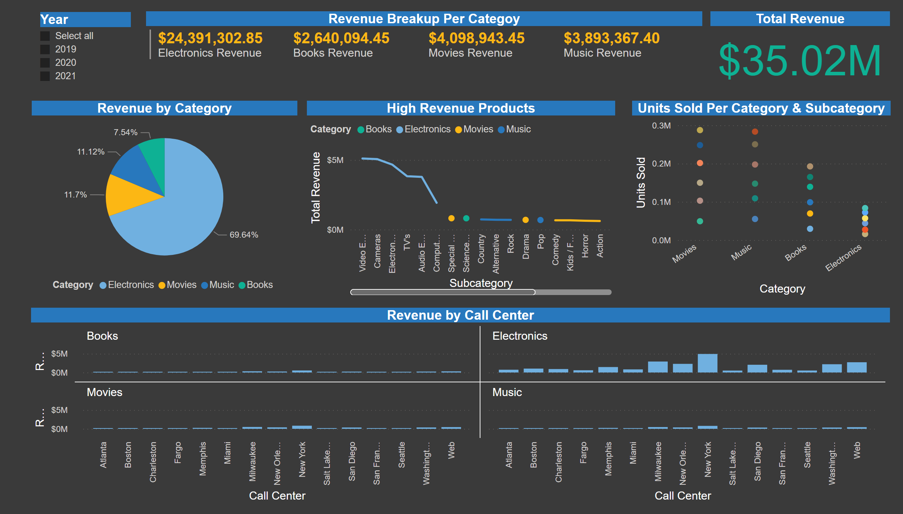
BSC Dashboard

Slide 4
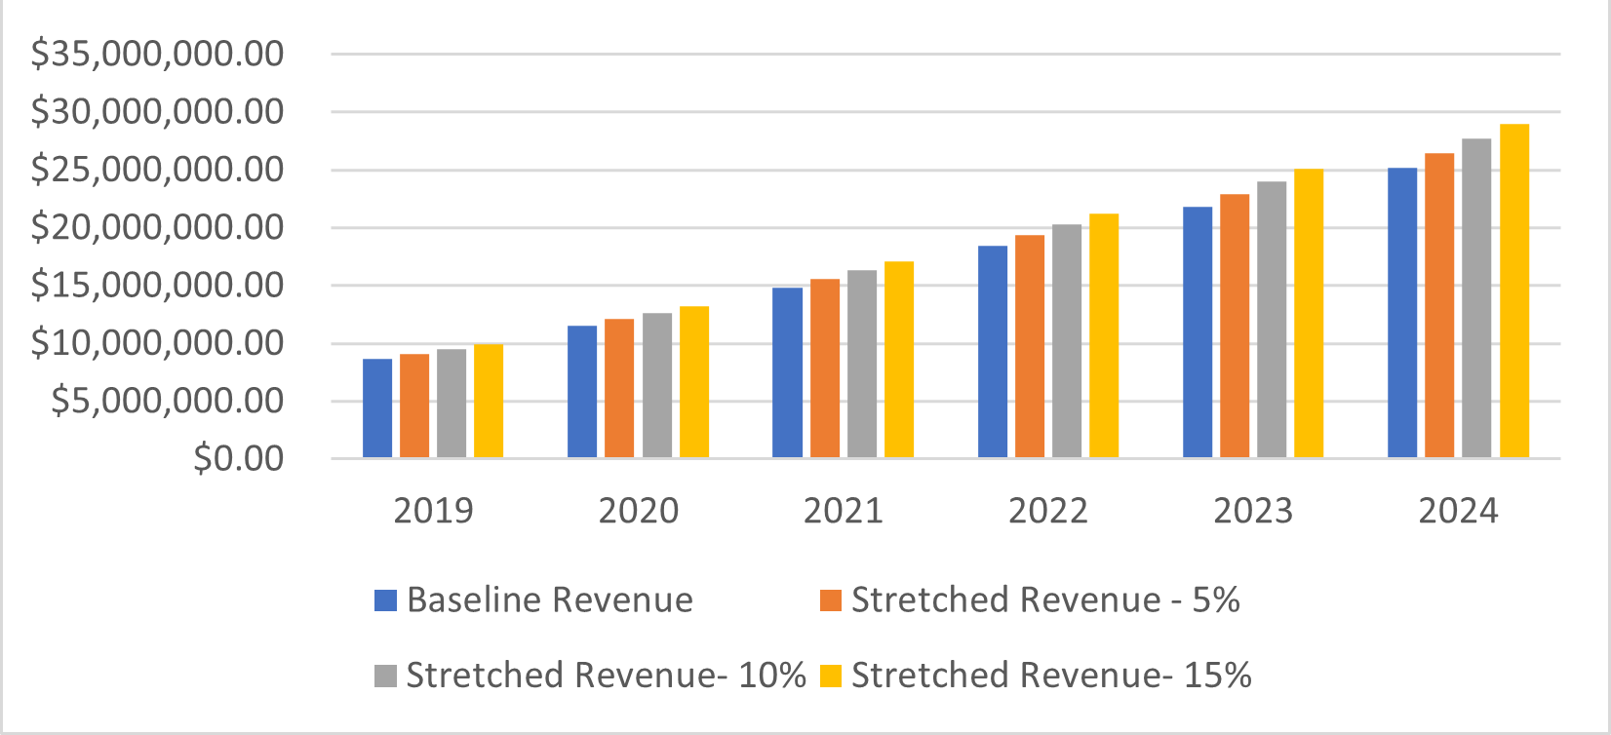
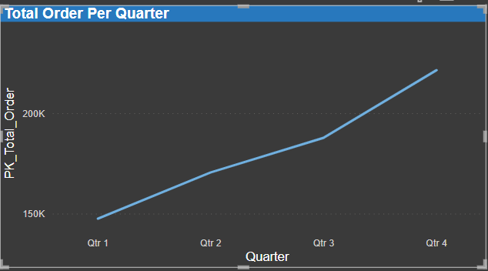
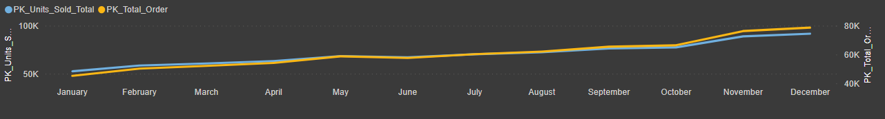
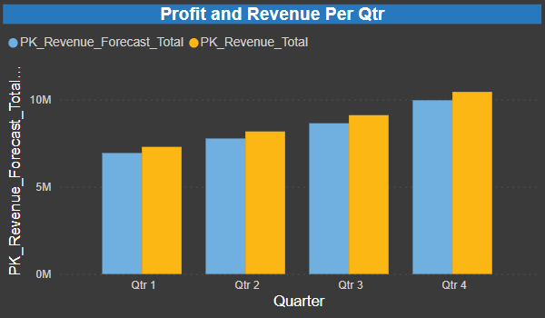
Linear Forecasting Year over Year
The chart shows the approximate Yearly baseline budget as well as the stretch revenue objectives of 5%, 10%, and 15%, respectively (Actual – 2019 to 2021 ; Forecast – 2022 to 2024):
Month-by-month revenue and revenue forecast

Slide 5
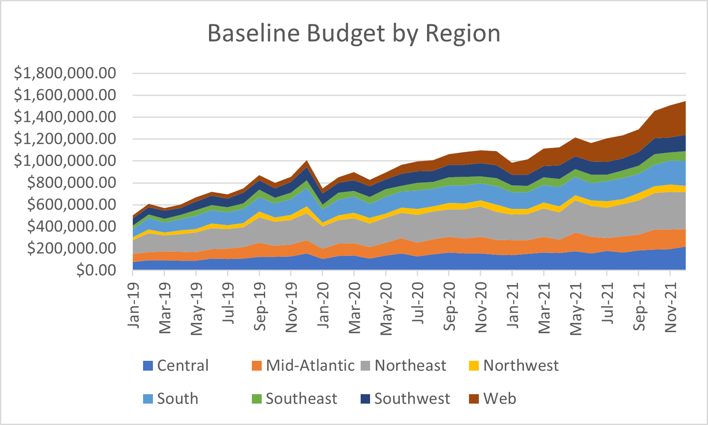
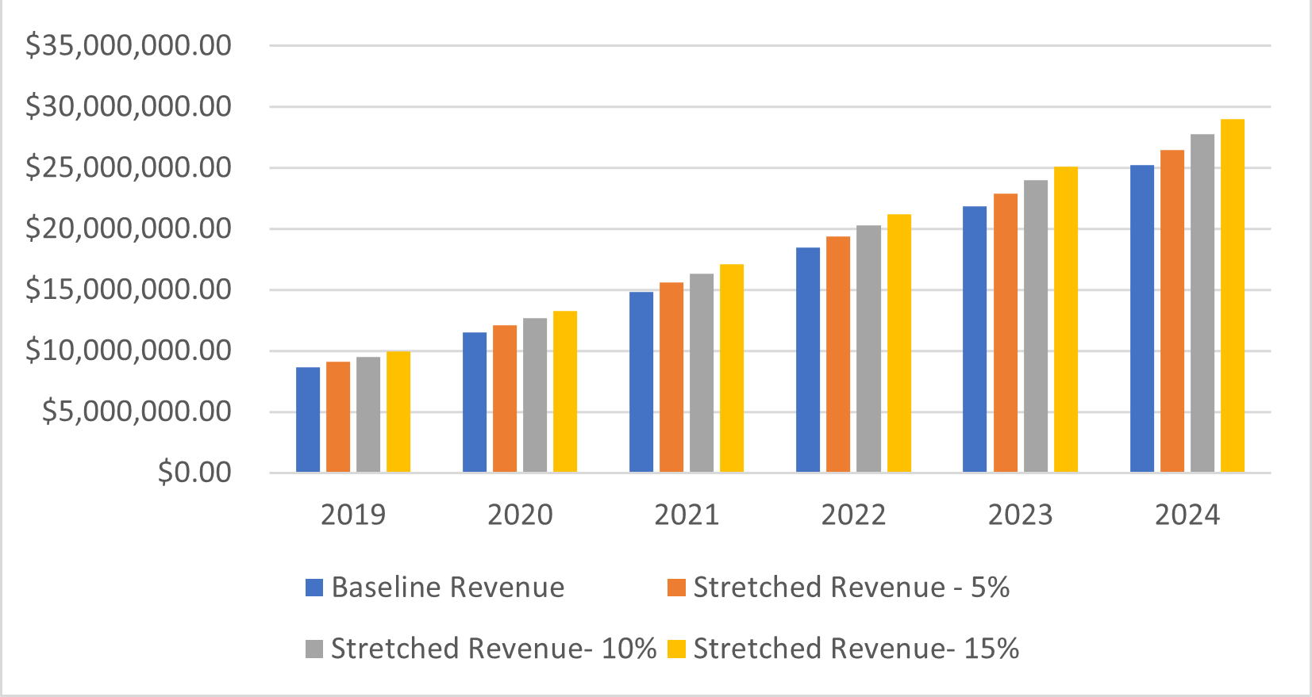
Percentage Stretch Budget-5%,10%,15%
The chart shows the approximate Yearly baseline budget as well as the stretch revenue objectives of 5%, 10%, and 15%, respectively (Actual – 2019 to 2021 ; Forecast – 2022 to 2024):

Slide 6
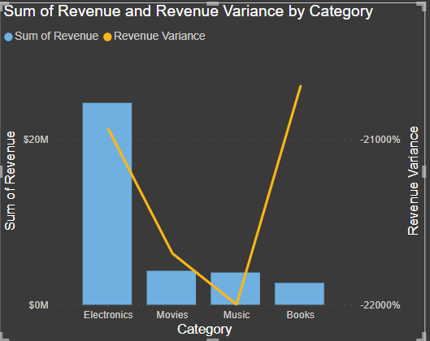
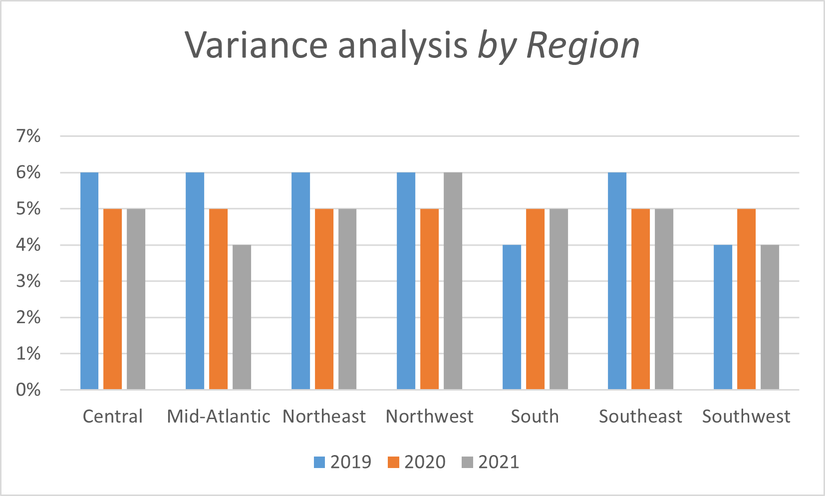
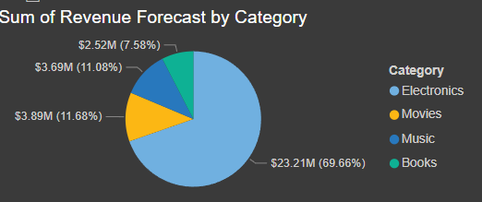
Variance analysis by Region
When compared to the national average, the category with the most overall success is electronics with revenue expected up to $23.21M followed by Movies and Music contributing to 11.68% and 11.08%

Slide 7
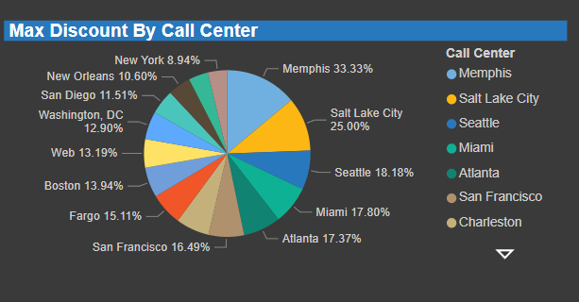
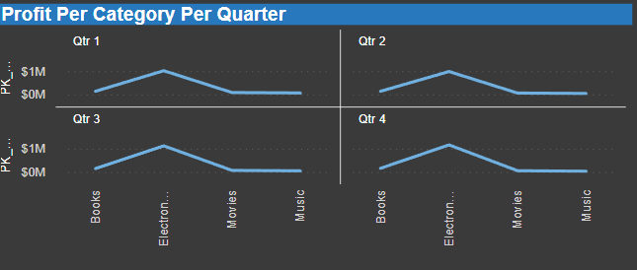
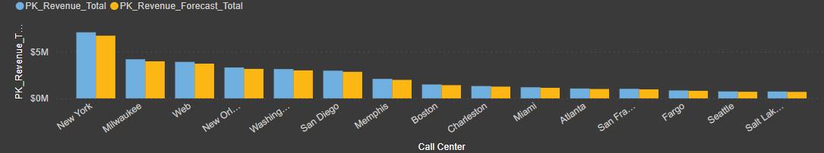

Slide 8
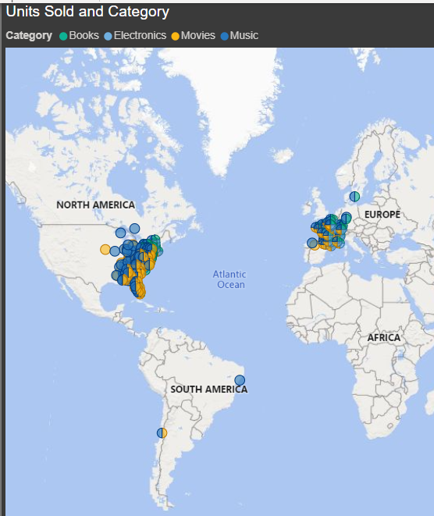
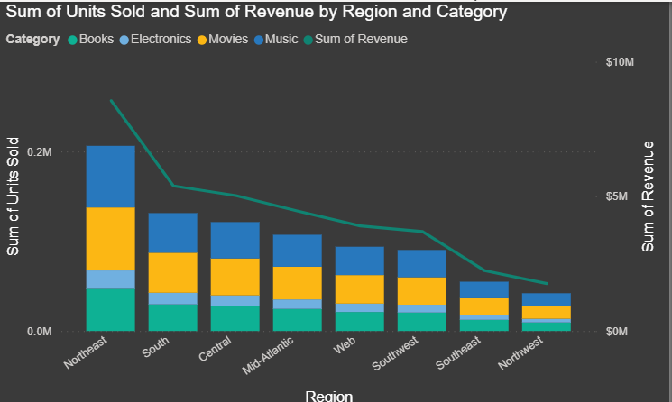
Comparing regions, the Northeast has been the most outperformer when compared to the national average and Northwest being the lowest contributor.

Slide 9
Risk
A potential risk is that the new products we choose do not perform as well as we had hoped they would.
We may incur a financial loss due to our failure to sell enough of the new products to recover the costs of their purchase.
Alternatively, it may choose not to cover the marketing and other expenditures involved with introducing those new products.

Slide 10
Recommendations
To expand the distribution channels.
To focus on the promotion of our products.
To increase the consumer’s awareness of our products.
To make their products more convenient to use.

Slide 11
Conclusion
The financial overview should describe what the firm is, how it will earn money, how much it will cost to establish and operate, and what consequences it will have on the economy and other businesses using the information provided.
Overall, if our strategy, the economy, market competitiveness, and other factors remain same or improve from where they are now, the company will do well.

